Slide 1
MS4
Team 22
The Servo Sheriffs
Group Members: Cora Huff, Lucas Goellner, Emerson King, Kip Pearce, Selena Zou

Slide 2
Role overview
Role:
Saloon RMP focused on placing hats on hooks
Strategy
Goes through the saloon door that RMP 2 holds open
Prioritizes taking gold hats from robbers heads and placing on hooks
Places blues on hooks if time permits
Parks in parking spot
Justification of selection
Due to the high point value of the hats at RMP with a role focused on hanging hats is necessary
Gold hats on hooks are worth 25 points
Blue hats on hooks are worth 20 points
Parking is worth 5 points

Slide 3
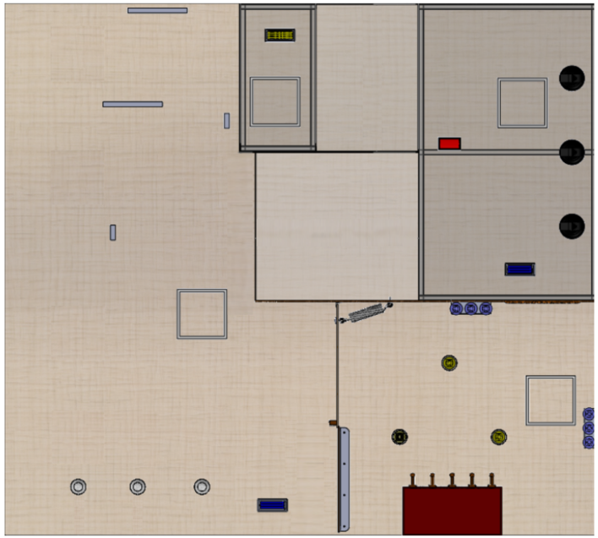
RMP Movement
1. Starts in parking spot in front of the ramp
RMP

Slide 4
RMP Movement
1. Starts in parking spot in front of the ramp
2. Goes through the saloon door that RMP 2 holds open
RMP
RMP 2
RMP

Slide 5
RMP Movement
1. Starts in parking spot in front of the ramp
2. Goes through the saloon door that RMP 2 holds open
3. Takes gold hats off of the robbers and puts them on the hooks
RMP

Slide 6
RMP Movement
Depending on time remaining:
4. Picks up blue hats and puts them on the hooks
Or
4. Parks
Depending on RMP 4 progress:
Parks in saloon
Or
Near the bottom of the ramp
1. Starts in parking spot in front of the ramp
2. Goes through the saloon door that RMP 2 holds open
3. Takes gold hats off of the robbers and puts them on the hooks
RMP

Slide 7
Functional Requirements
Company Name
Date
RMP must be able to successfully grab hat 50% +/-25% of the time, and hook and release hat 50% +/-25% after a successful grab.
01
02
RMP must be able to pivot 180 degrees while inside the saloon +/- 30 degrees.
03
RMP must be able to lift hats off the robbers and up to an elevation of 7 inches +/-2 inches.

Slide 8
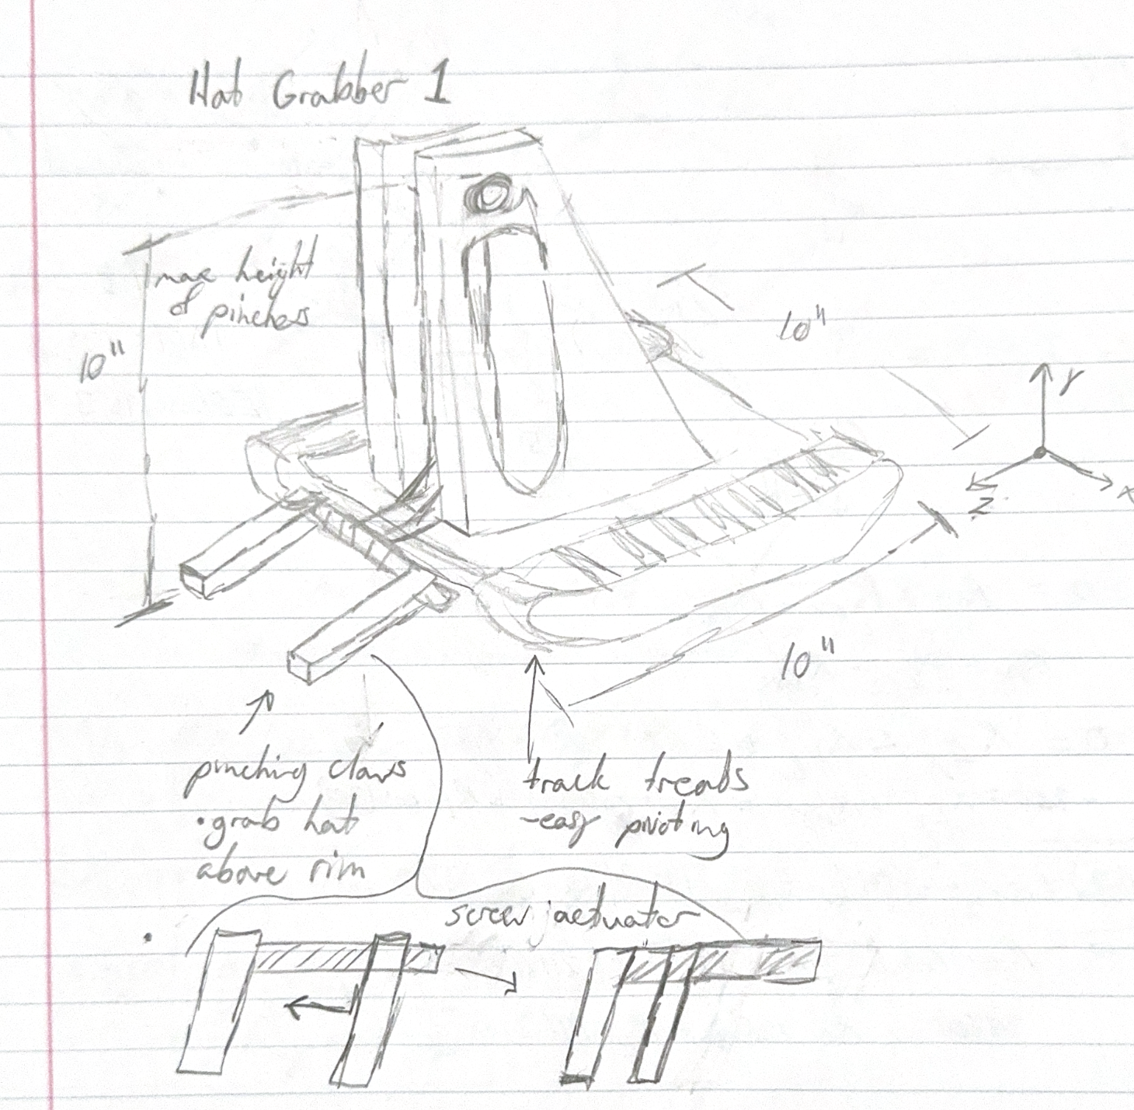
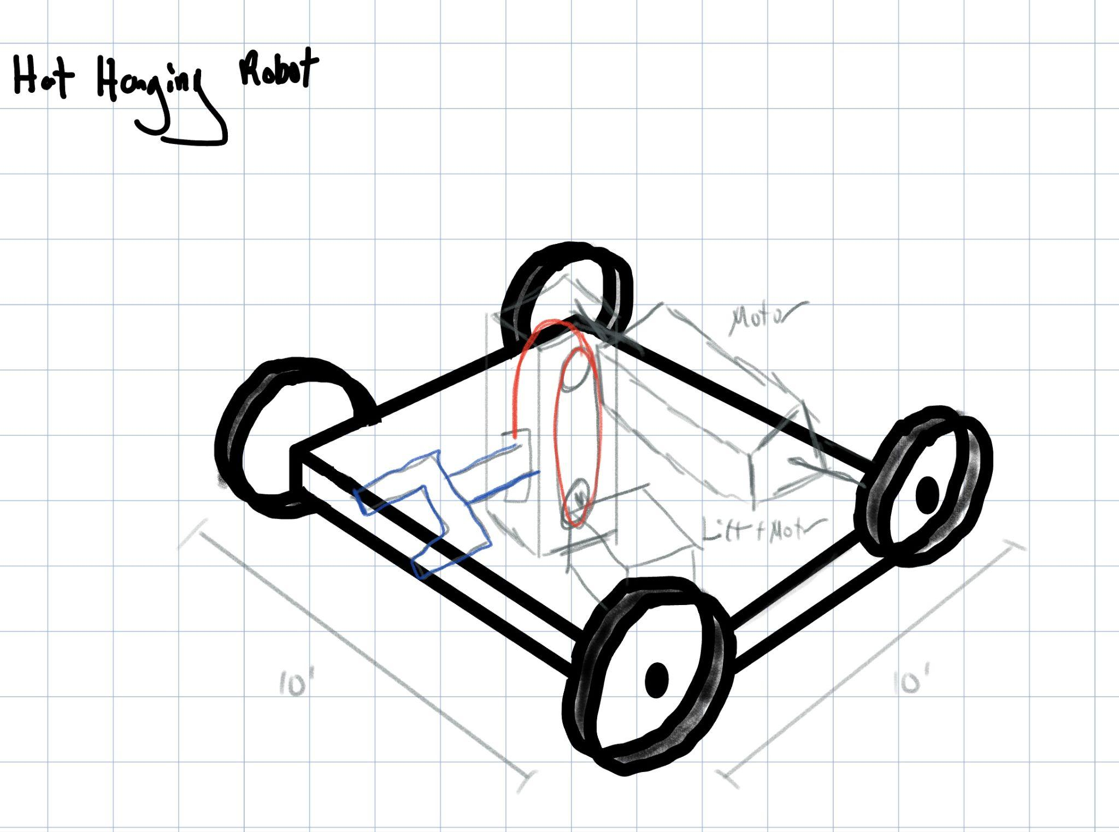
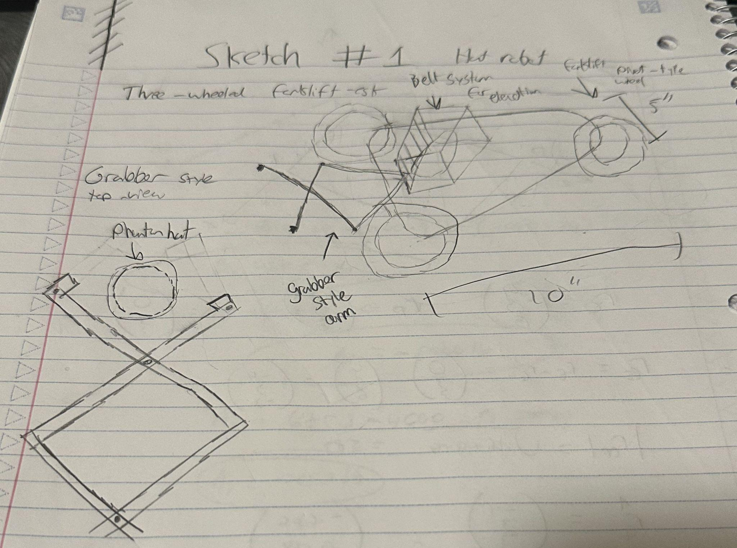
Design Concepts
Design 1
Design 2
Design 3

Slide 9
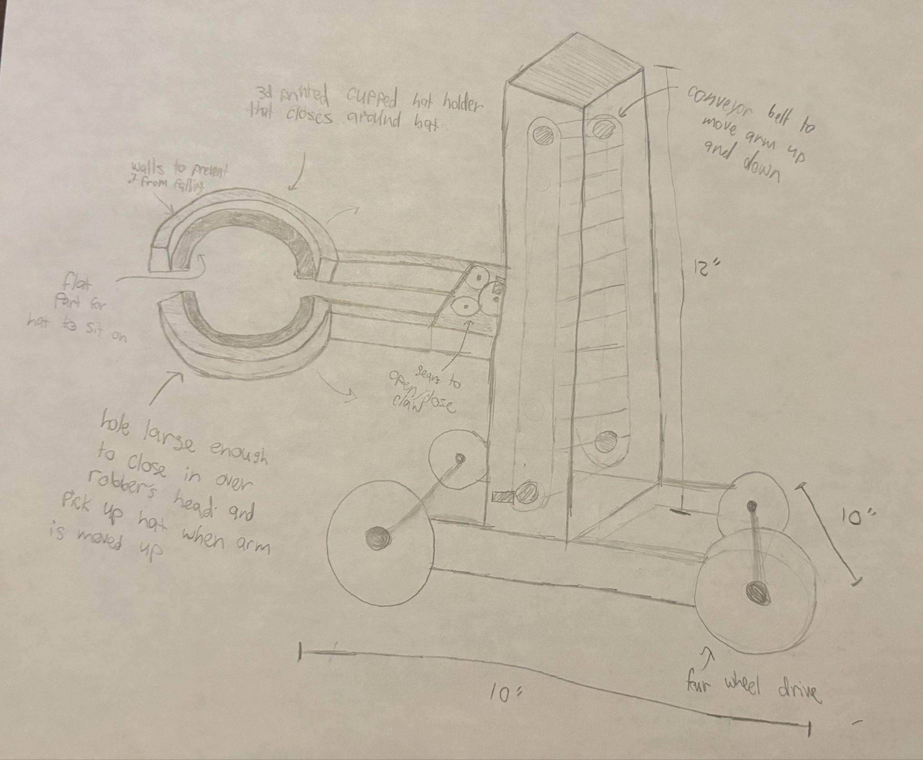
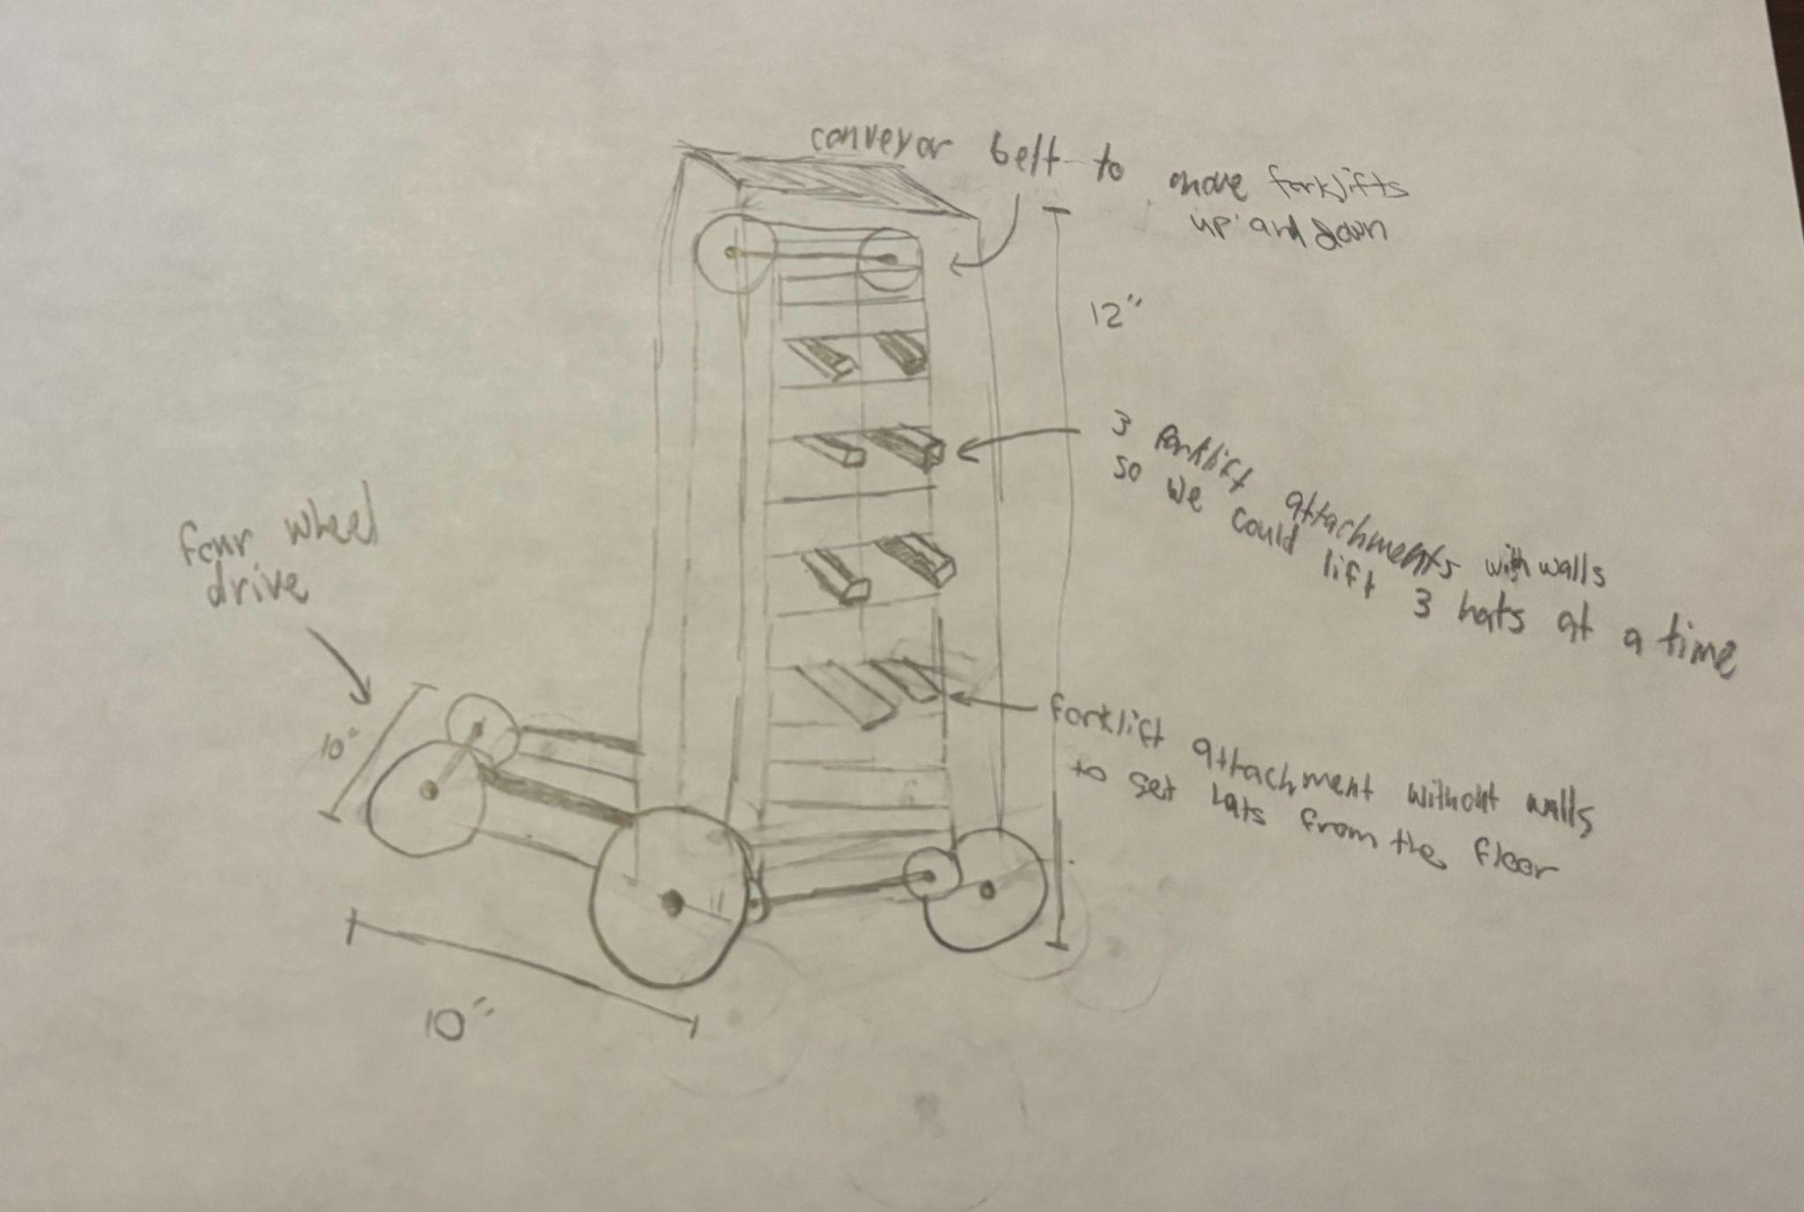
Design Concepts
Design 4
Design 5

Slide 10
Pugh Chart
Requirement | Weight | DC1 | DC2 | DC3 | DC4 | DC5
Able to grab and release hats 50% of the time | 5 | 1 | -1 | 0 | 1 | -1
Able to pivot 180 degrees in the saloon | 4 | 1 | 1 | 0 | 0 | 0
Able to lift hats off the robbers and up to an elevation of 7 inches | 4 | 0 | 1 | 0 | 1 | 1
Manufacturability | 3 | -1 | -1 | 0 | -1 | -1
Creativity | 1 | 0 | 1 | 0 | 1 | 1
Total | - | 6 | 1 | 0 | 7 | -3

Slide 11
Company Name
Date
Trade Offs
Abstract and creative designs are harder to manufacture
More complex design require more parts
Each design scores well in one function
Poor manufacturability is not a terminating factor

Slide 12
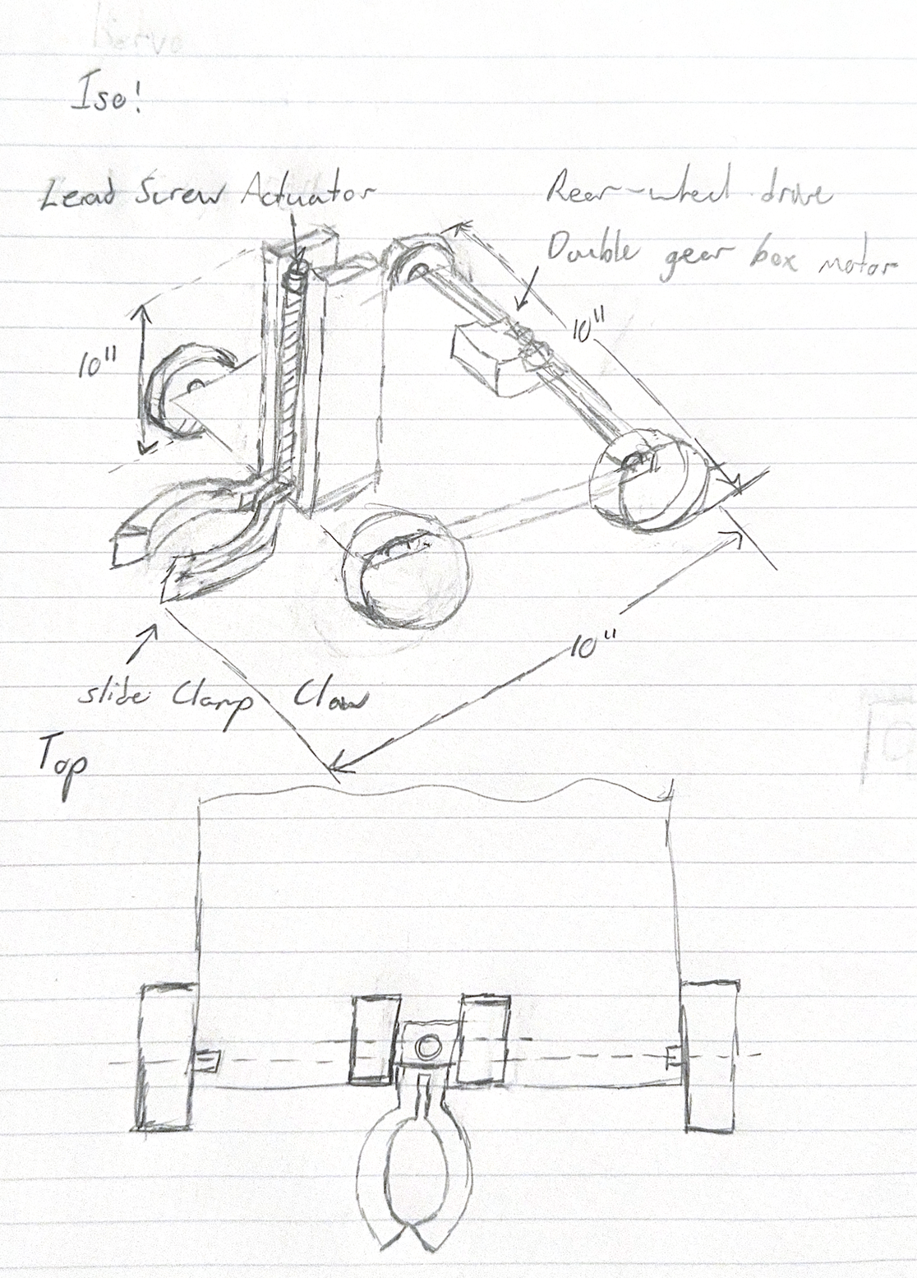
Final Concept
Justifications:
Claw allows RMP to quickly and securely pick up hats
Drivetrain includes four wheels with a double gear box which will allow RMP to turn
Lead screw actuator ensures RMP can move the claw up and down so that it can lift the hat
Design limits excessive number of parts which makes manufacturing easier
Claw allows for creative designs which will be tested in our empirical testing

Slide 13
Final Concept

Slide 14
Decision Variables
Drivetrain:
Wheel material
Motor torque
Wheel placement
Most important:
Wheel material
Motor torque
First principle testing
Lift:
RPM of motor
Height of elevator
Placement of the lift on the drivetrain
Most important:
RPM of motor
First principle testing
Claw:
Shape of claw
Thickness of claw
Infill of claw
Most important:
Shape of claw
Empirical testing

Slide 15
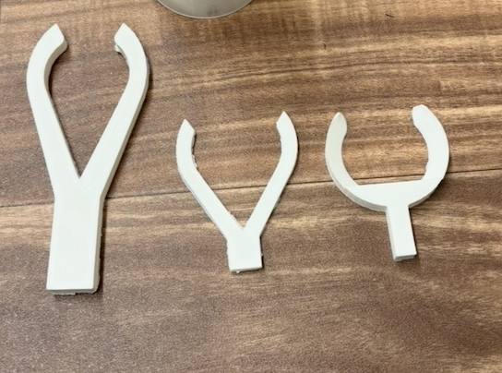
Empirical Testing
What we hope to learn:
Do our designs work?
Do we grab underneath hat or clamp from above?
What clamp design is the most successful at clamping?
What clamp design is the most successful at hooking?
1.
2.
3.

Slide 16

Empirical Testing

Slide 17
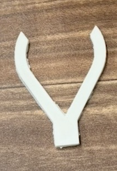
Testing Winner
Clamp 2
Grab success rate 90%
Hook success rate 90%

Slide 18
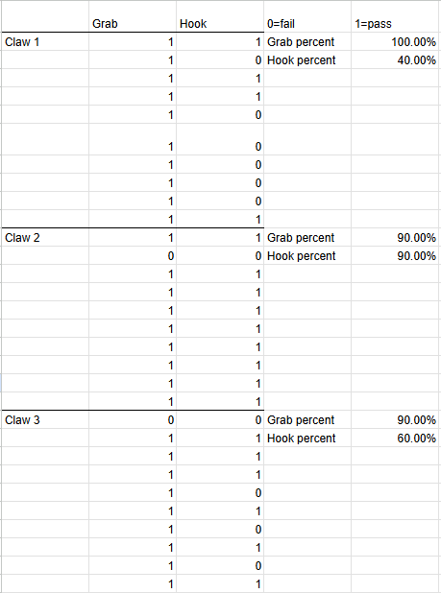
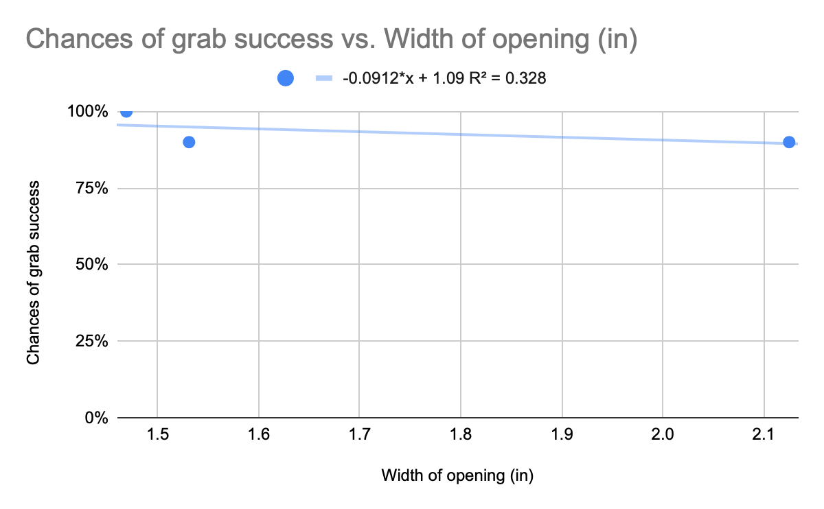
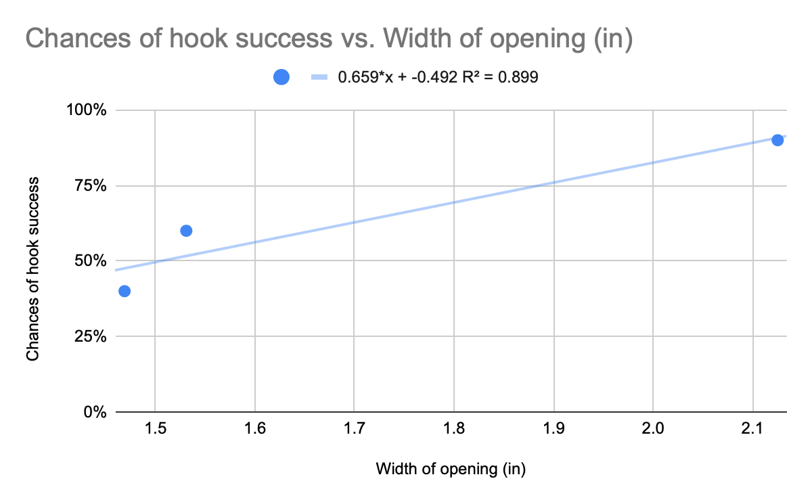
Testing Data
Notes:
End Selena
\

Slide 19
Analytical Testing: RPM Torque
Situation: Lift needs to be able to raise the claw in a reasonable amount of time
Task: Find the minimum required RPM of the motor to lift the claw 7 inches in 10 seconds.
Results: Motor must rotate at a minimum of 840 RPM

Slide 20
Analytical Testing: RPM Torque
Assumptions:
Negligible thread friction
Thread pitch is nominal to manufacturer specifications
Motor will be able to apply sufficient torque
Why Assumptions work:
Small amount of friction, small manufacturer tolerances, adjustable motor
FNV
FNR
FNT
FNT
FG
FNR
FNR
FNT
FNT
FNR

Slide 21

Analytical Testing: Revs per minute
Birds eye view of carriage
EOMs:
FNV - FG = ma
FNV
FNR
FNT
FNT
FG
Results:
The motor attached to the lead screw needs to turn at least 840 RPM in order to raise the claw 7 inches in 10 seconds.
FNR
FNR
FNT
FNT
FNR

Slide 22
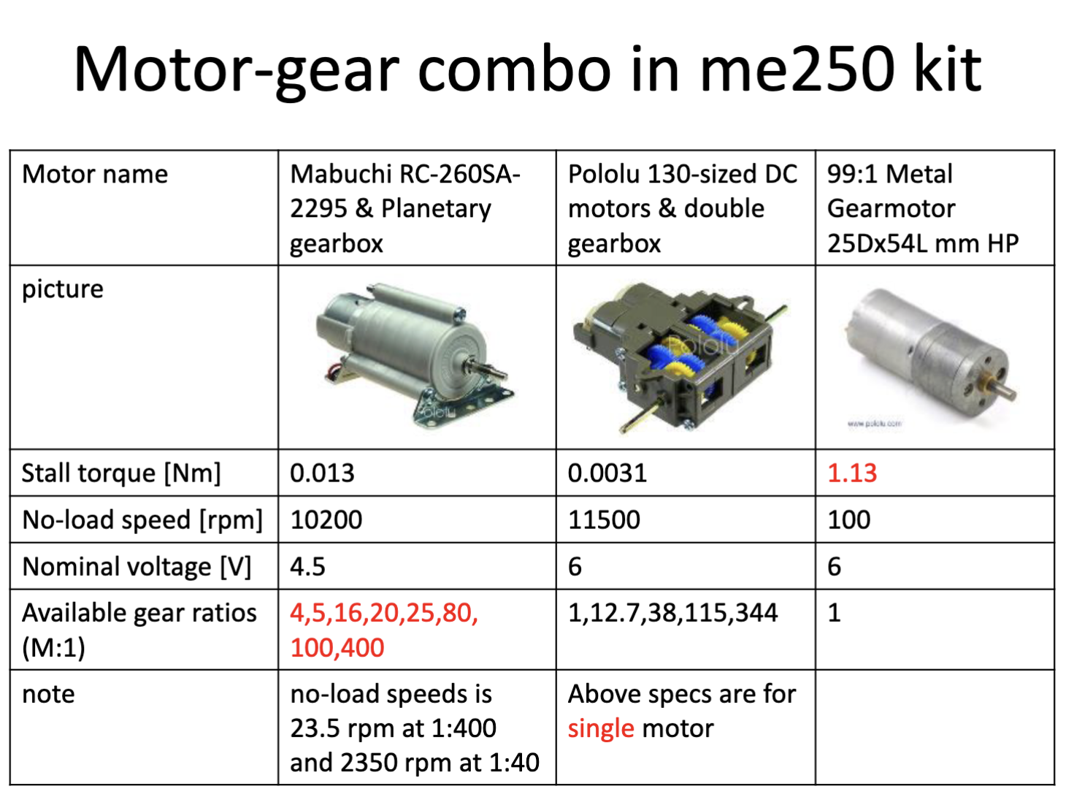
Analytical Testing: Motor Torque
Situation: RMP needs to drive 5lb robot with two rear wheels
Task: To find the minimal torque for our motors to drive our robot
Results: Motor with torque of 0.89 Nm
Notes:
In motor comparison we find that only our 99:1 Gear motor provides the necessary stall torque (1.13Nm) while the dual gearbox (even with a 344:1 gear ratio) only provides 0.255Nm of torque.

Slide 23
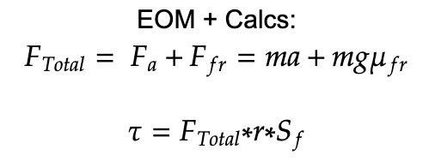
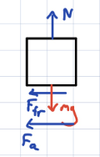
Analytical Testing: Motor Torque
Assumptions:
Rear motors drive robot with individual motor
Assumed acceleration of 1.5m/s^2
Coefficient of friction is 0.6 (calculated between rear rubber wheels and game floor base)
Why Assumptions work:
CoM relatively centered, Contact area constant, Constant Friction coefficient

Slide 24
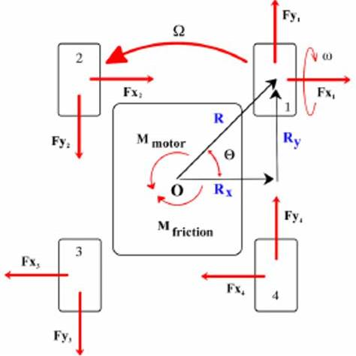
Analytical Testing: Wheel Turning
Situation: Robot needs to turn in tight spaces with 0 in turning radius.
Task: To Find Maximum friction 𝜇 (front wheels) needed for reliable turning (to not lock up).
Results: We found that the maximum coefficient of friction of the front wheels is 0.757. Which is satisfied by our front Polypropelene wheels (0.35).
Notes:
Action: Calculate Coefficient of friction using first principles analysis of Vehicle dynamics.

Slide 25
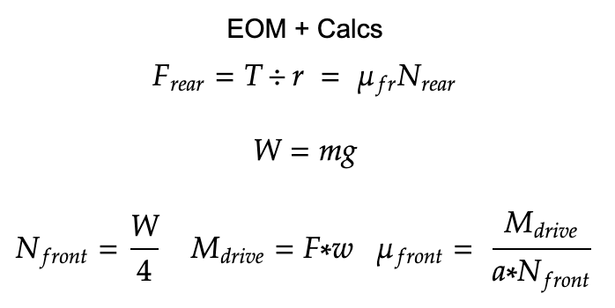
Analytical Testing: Wheel Turning
Assumptions:
Center of mass in in middle
Equal distribution of mass on wheel
Assumed acceleration of 1.5m/s^2
Why Assumptions work:
CoM relatively centered, Contact area constant, Constant Friction coefficient

Slide 26
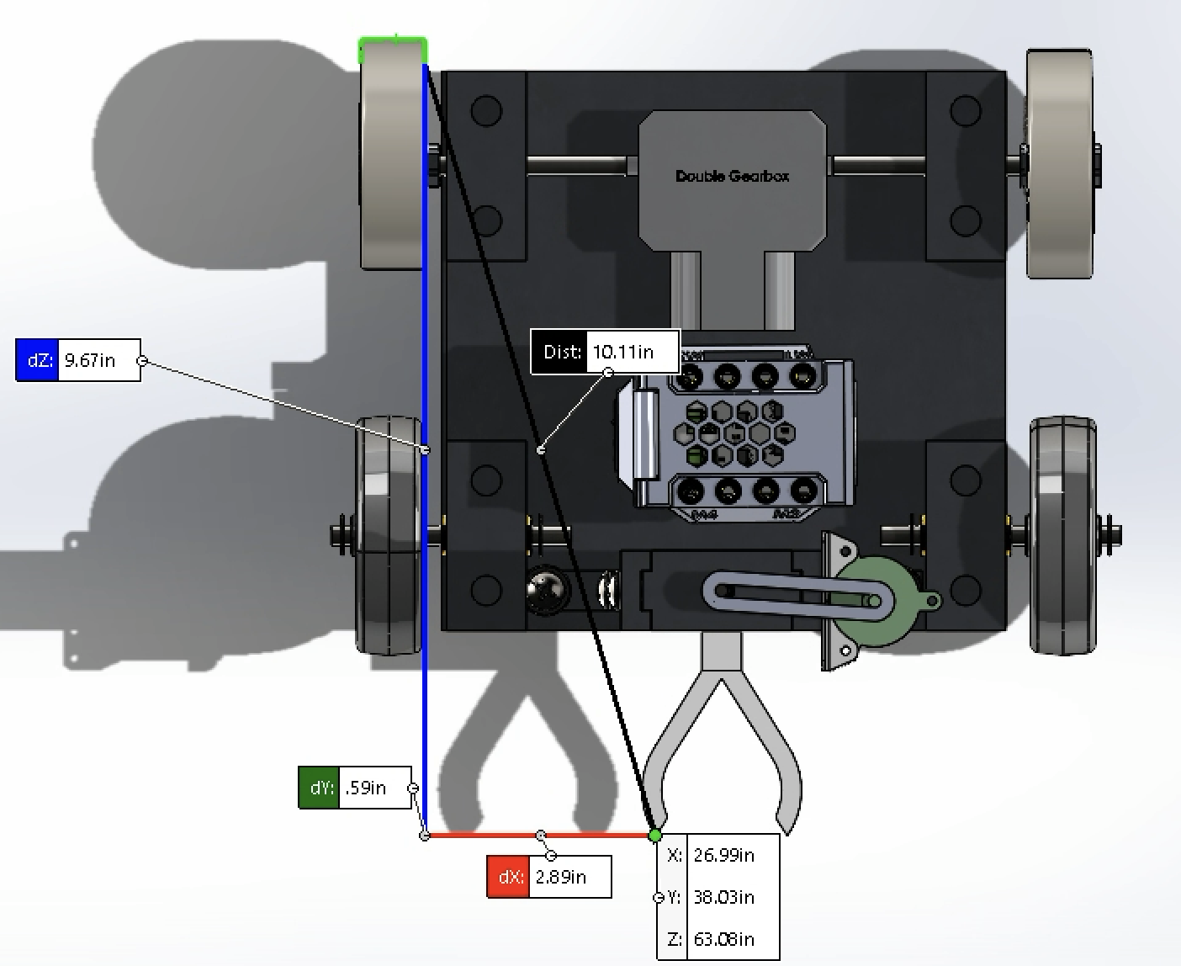
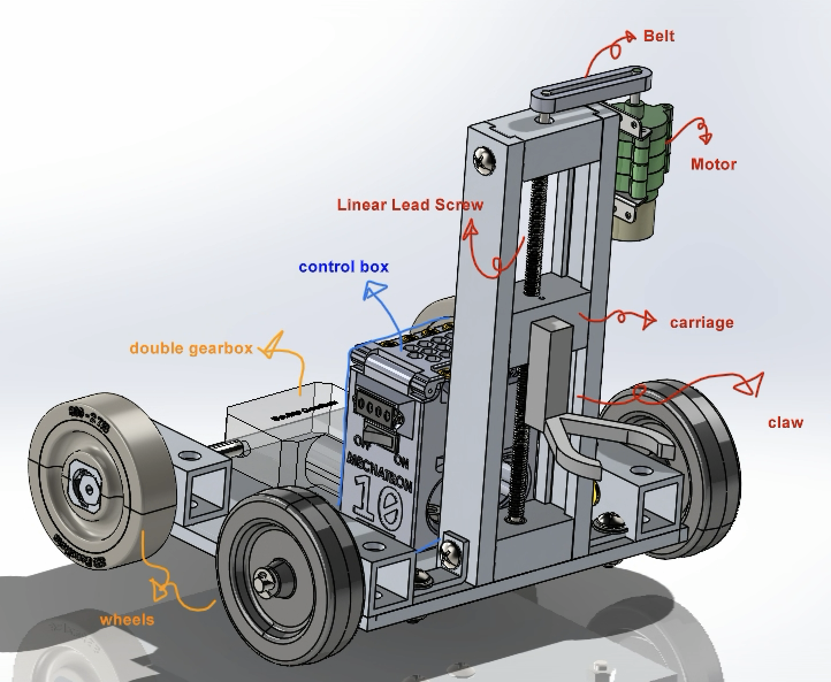
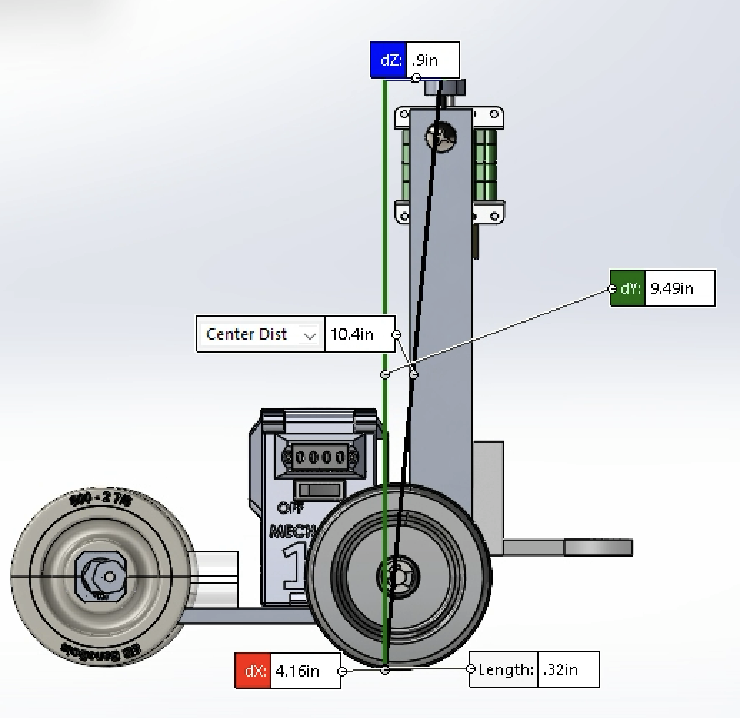
CAD: Motors
Dimensions:
9.49" x 9.67”
Notes:
End Emerson,
Start Kip

Slide 27
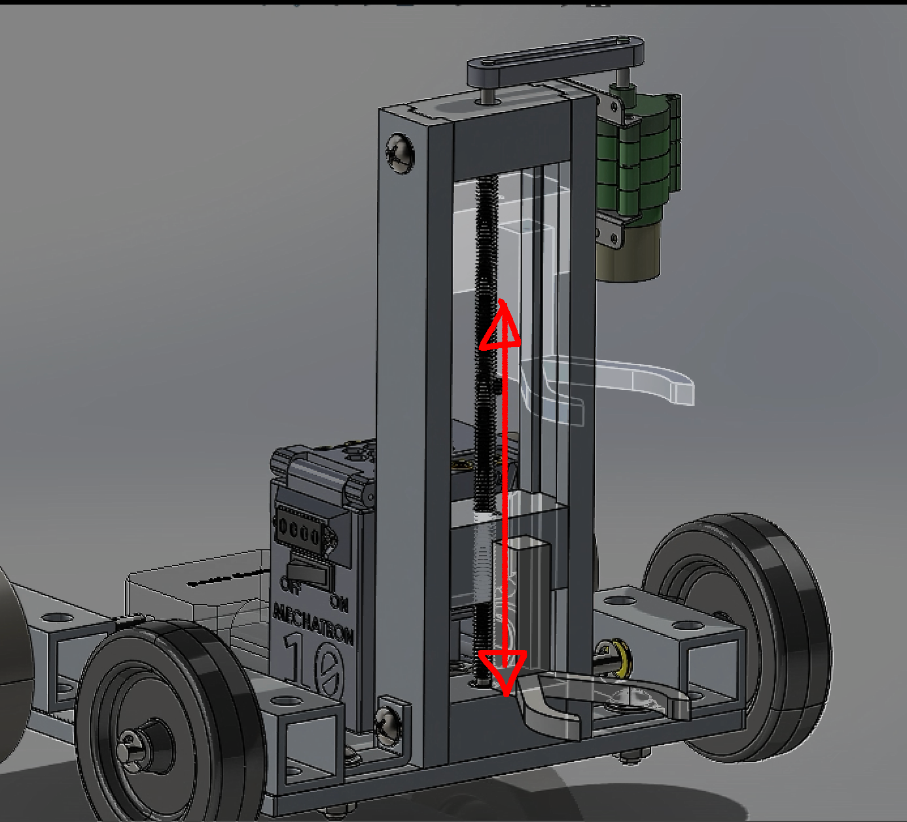
CAD: Motion

Slide 28
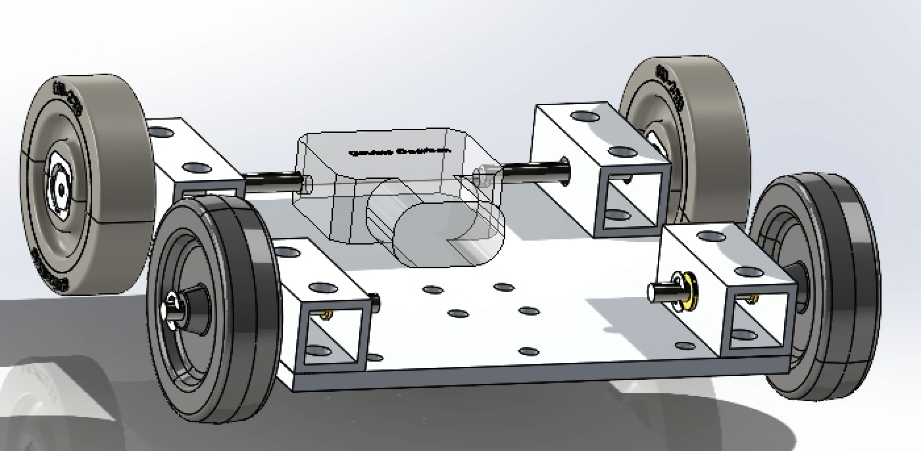
Subsystem: Drivetrain

Slide 29
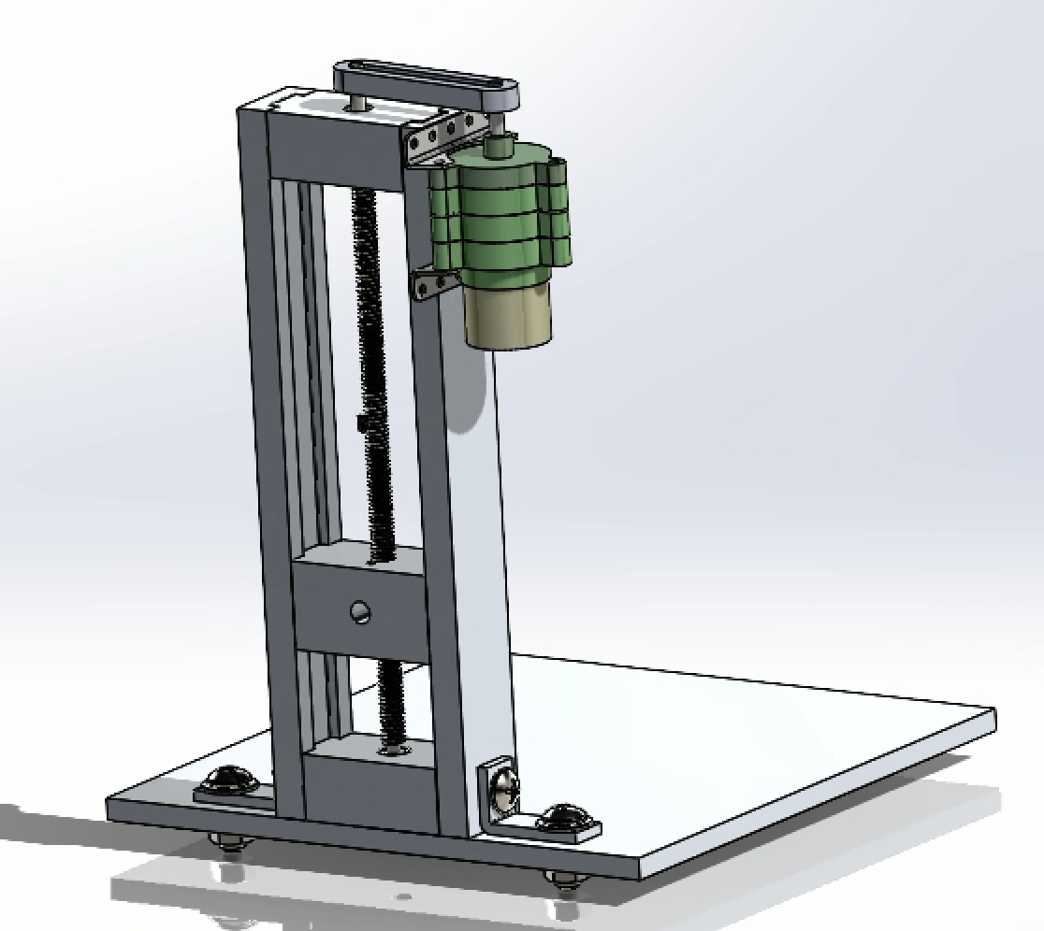
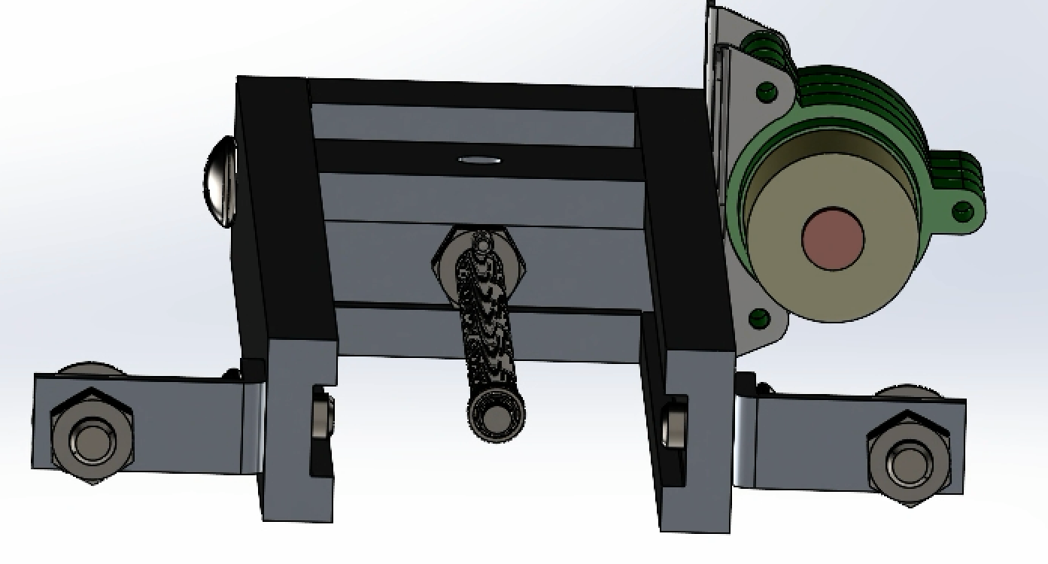
Most Critical Subsystem: Lift
Bearing Blocks
Motor
Carriage
Nut & Retaining Groove
“Lead” Screw
Guide Rail
Notes:
Start Emerson

Slide 30
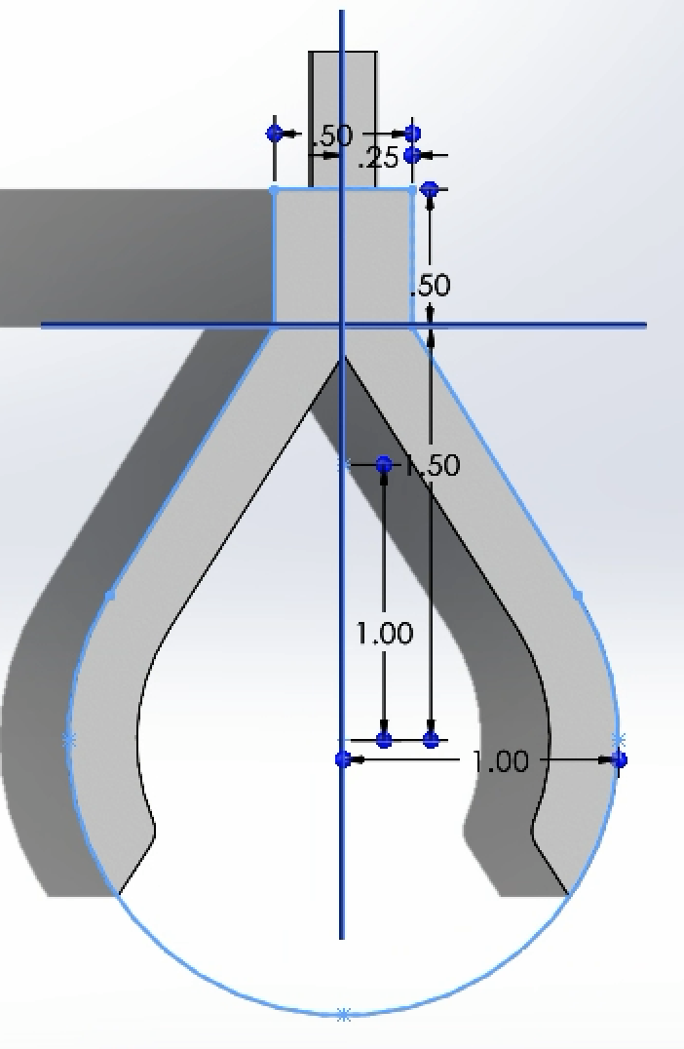
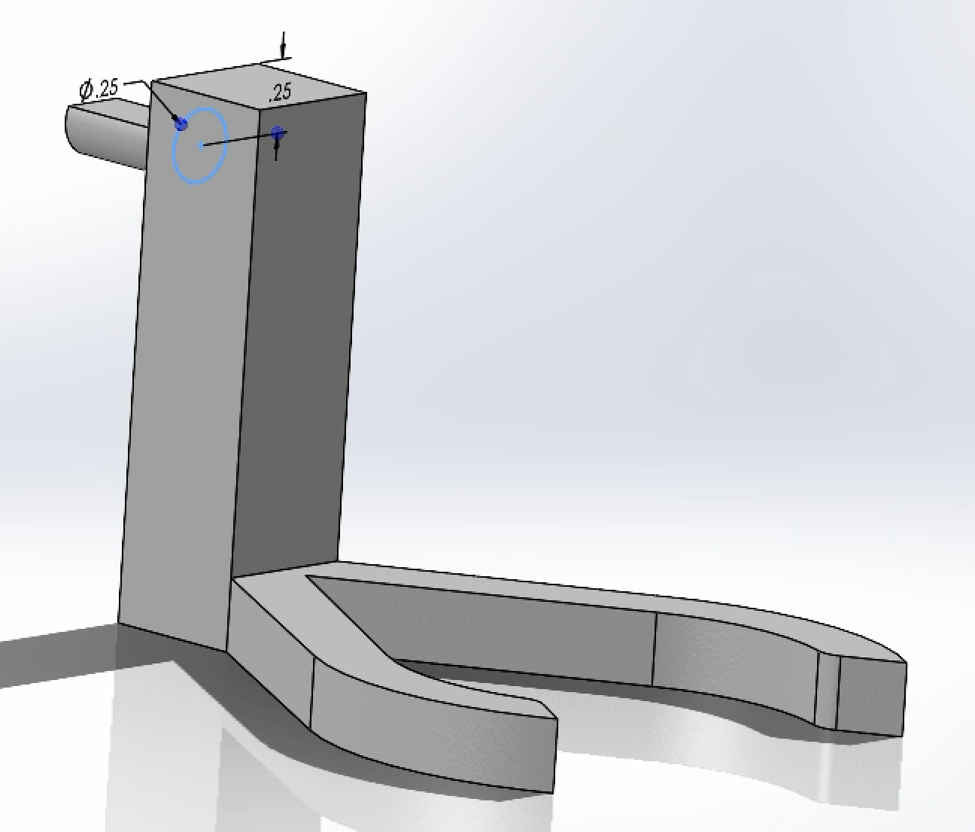
Subsystem: Claw
Notes:
Start Selena

Slide 31
Summary
Materials:
Two 3/16th ID bearings for lead screw journals
New motor for drivetrain
Challenges:
Screw and the bearing blocks must have tight tolerances to press fit
Securing lead screw actuator
Tension on belt
Time constraints
Claw durability
Notes:
Start Lucas

Slide 32
Summary
Risks:
Lining up RMP to lift hat could be time consuming
Lead screw actuator could be time consuming to manufacture
Concerns:
Current claw design leaves hats unsecured when transporting
Weight of carriage and efficiency of belt
Notes:
Start Lucas

Slide 33
Q&A
Any questions?
Ask away!

Slide 34
Appendix

Slide 35
Functional Requirements Justifications
Company Name
Date
With a high success rate of grabbing the hat the RMP can then proceed to racking and scoring hat points.
01
02
Turning around is crucial so that the RMP can direct onto a hook.
03
The RMP needs to be able to lift the hat high enough to get it off of the robbers’ heads and to the hooks.
Notes:
End Cora:
Start:

Slide 36
Weightings
Company Name
Date
Requirement | Weight | Justification
Able to grab and release hats 50% of the time | 5 | Highest priority because this is an ability unique to our RMP that is essential for its task completion
Pivot 180 degrees in the saloon +/- 30 degrees | 4 | High priority because this is an ability that is essential for our RMP’s task completion but likely not unique to our RMP
Lift hats off the robbers and up to an elevation of 7 inches +/-2 inches | 5 | Highest priority because this is an ability unique to our RMP that is essential for its task completion
Manufacturability | 3 | Average priority because our RMP needs to be feasible to manufacture but it is acceptable if it has some challenging aspects to manufacture
Creativity | 1 | Low priority because a simple RMP could be more efficient at completing it’s functional requirements

Slide 37
Design Concept 1
Function Requirement Justifications:
Clamping/pinching claw allows for the RMP to grab the hat securely
Track treads allow the RMP to pivot very easily, allowing for a 180 degree turn inside the saloon
Screw actuator in the vertical spine allowing for the hats to be lifted up to 10 inches

Slide 38
Design Concept 2
Function Requirement Justifications:
Grabbing claw allow the RMP to quickly secure hats from longer distances
Allows for better maneuverability with the pivot wheel and a smaller turning radius
Belt system can lift the hats to elevations of at least 7 inches

Slide 39
Design Concept 3
Baseline design
Function Requirement Justifications:
Lift features a hook that can pick up hats quickly
Tank drive to maneuver and turn in tight areas
Lift design allows hats to be raised at least 7 inches

Slide 40
Design Concept 4
Function Requirement Justifications:
Cup-like claw allows hats to lifted securely and quickly
Four-wheel drivetrain design to allow RMP to turn 180 degrees
Vertical belt lift that allows hats to be lifted at least 7 inches

Slide 41
Design Concept 5
Function Requirement Justifications:
Multiple claws to lift multiple hats at once to reduce hat retrieval time
Four-wheel drivetrain design to allow RMP to turn 180 degrees
Vertical conveyor belt lift that allows multiple hats to be lifted at least 7 inches

Slide 42
Decision Variables: Drivetrain
Drivetrain:
Wheel material
Motor torque
Wheel placement
Most important:
Wheel material
Motor torque
First principle testing
Justification:
Wheel material: The wheels of the RMP need to have enough friction so that the RMP does not slip but they also need little enough friction so that the motor can still drive the RMP.
Motor torque: The torque of the motor needs to be strong enough to turn the wheels and drive the RMP.
Wheel placement: The wheels need to be set up on the RMP in a way that allows the RMP to efficiently turn.
Being able to efficiently drive and turn the RMP will help to complete our functional requirement of turning 180 degrees.
The most important variables were the wheel material and the motor torque so we did testing on those variables. We choose to do first principle testing on these variables because they were feasible to do based on material and motor data.

Slide 43
Decision Variables: Lift
Lift:
RPM of motor
Height of screw
Placement of the lift on the drivetrain
Most important:
RPM of motor
First principle testing
Justification:
RPM of motor: The RPM of the motor is important because it would tell us how fast the motor needs to be spinning in order to lift the claw in a reasonable amount of time.
Height of screw: The height of the screw is important because our claw needs the ability to be lifted high enough to pick up the hat and put them on the hook. However, the screw also can’t be too high because we could risk the RMP tipping.
Lift placement: The lift must be place somewhere that is far enough out so that the claw can reach the hat but it also needs to be far enough in so that it can stable and secured.
Being able to efficiently raise and lower the lift will help to complete the functional requirement of lifting the hats to the elevation of 7 inches.
The most important variable was the RPM of the motor. First principle testing was done on this variable because it was feasible to calculate the RPM of the motor with the screw pitch information.

Slide 44
Decision Variables: Claw
Claw:
Shape of claw
Thickness of claw
Infill of claw
Most important:
Shape of claw
Empirical testing
Justification:
Shape of the claw: The shape of the claw is important because it is the part making contact with the hat. It needs to be wide enough to fit around the robbers head or narrow enough to squeeze down over the top of the robbers hat. It also needs to be able to securely hold the hat.
Thickness of the claw: The claw needs to be thick enough so that the brim of the hat can sit on the claw or so that the claw is strong enough to not permanently warp when it picks up a hat.
Infill of the claw: The claw needs to be strong enough to lift a hat. Being able to limit the required infill would allow us to save money and make more iterations of the claw. However, the claw still needs to be strong enough to lift the hat.
Being able to pick up the hat in the claw will help to complete the functional requirement of picking up and releasing the hat at least 50% of the time.
This variable was tested with empirical testing because their was not a way to test the shape of the claw based on theoretical data. This also gave us the opportunity to more uniquely design each claw.

Slide 45
Empirical Testing
General Test: Hooking Test
Can the hat grab and hold a hat for 10 seconds?
Can the hat lay on the hook and release from the clamp?
Each attempt is counted as a pass or fail (1 or 0).
Procedure:
Three clamps designs will attempt 10 times each to grab and hook a gold hat from the robbers head.
Clamp attempt will count as one try to securing hat in clamp then lifting 4 inches and counting to 10s.
Hook attempt will count as 10s to get hat off of clamps and staying on hook.
If hat falls during transport it counts as a fail for both grab and hook.

Slide 46
Empirical Testing
Assumptions:
We can reach a height of 10 inches with the arm.
We can rotate and move.
The dexterity will be less with the RMP than human hands.
Assumption Reason:
Our design is for a 12 inch RMP height with the arm being able to go from 0 inches to 10.
Our mobility will provide us the ability to rotate and move.
We accounted for robot rigidity with our margin of error for functional requirement.

Slide 47
Empirical Results
Numerical Findings:
Clamp 1:
Grab Success Rate: 100%
Hook Success Rate: 40%
Clamp 2:
Grab Success Rate: 90%
Hook Success Rate: 90%
Clamp 3:
Grab Success Rate: 90%
Hook Success Rate: 60%
Conceptual Findings:
We found that scooping the hat from underneath had the highest success rate of grabbing and hooking.
The Clamp 2 was the most successful, though it was the least stable transportation.
The main reason we had such a high success rate in transport was due to human dexterity.
We will add taller supports to the side of the clamp 2 design in order to secure the hat.

Slide 48
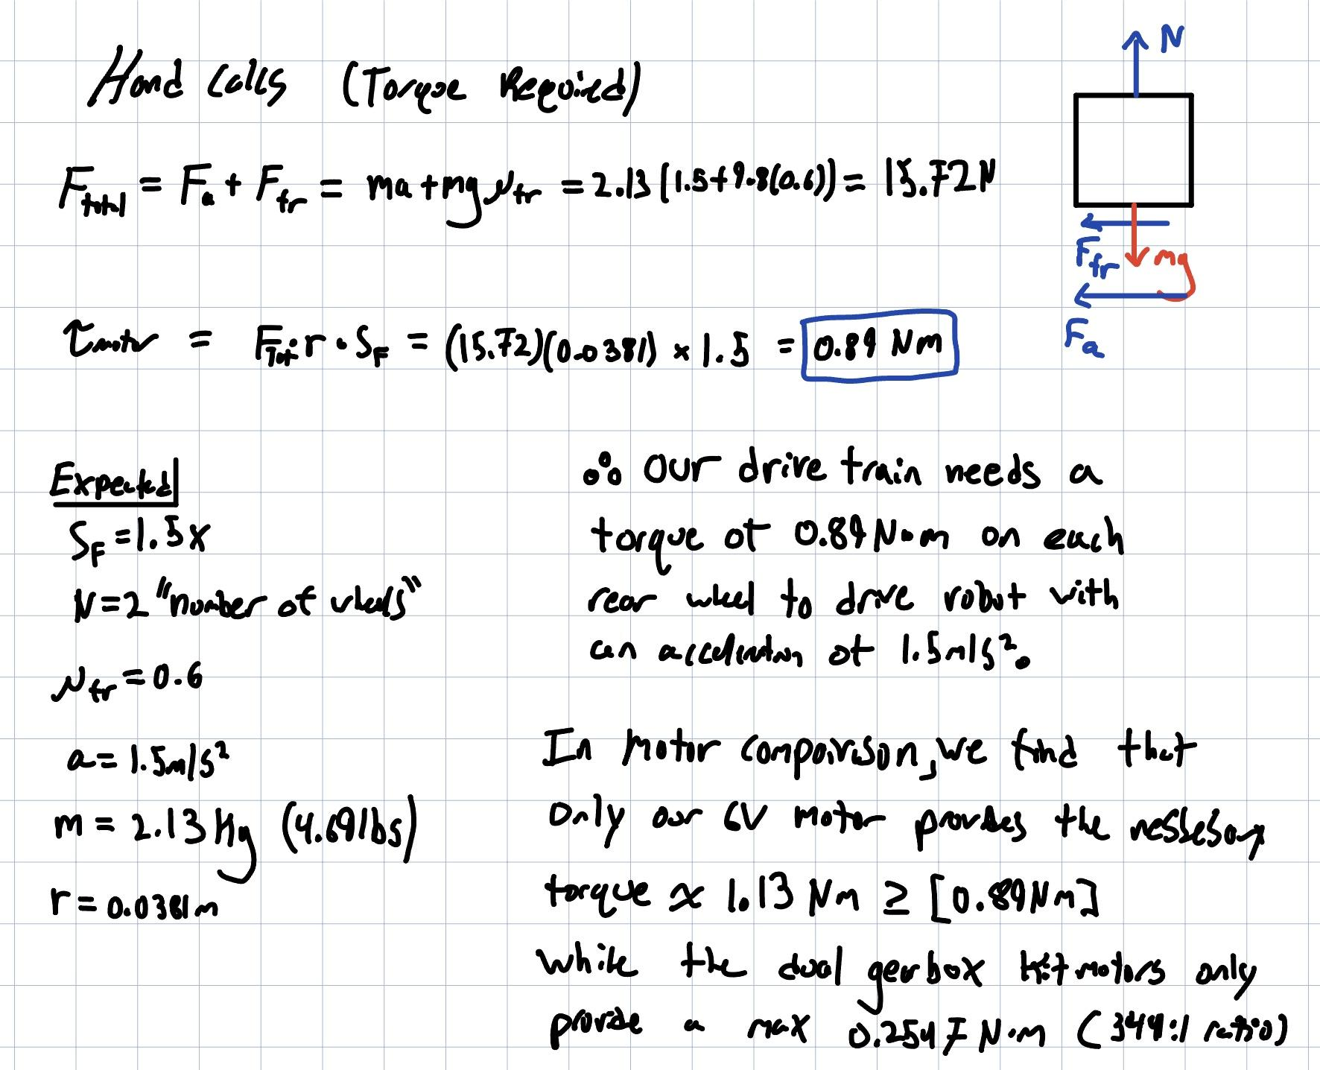
Analytical Testing: Motor Torque

Slide 49
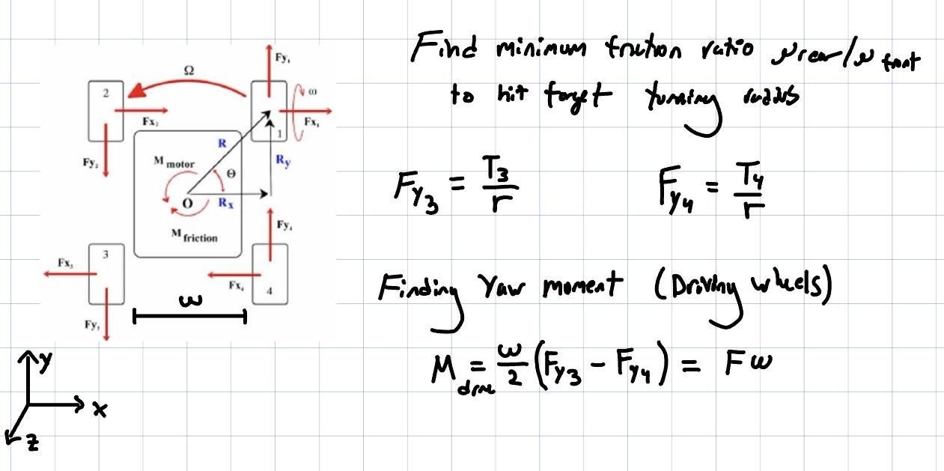
Analytical Testing: Wheel Turning

Slide 50
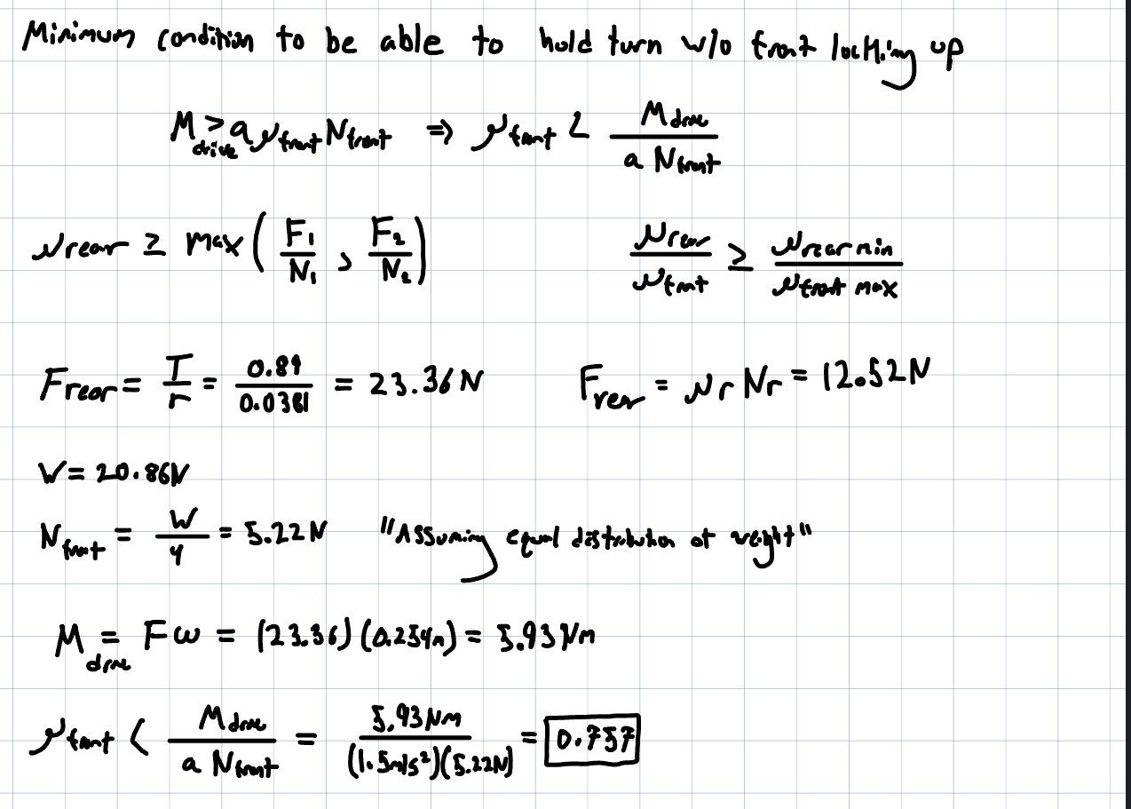
Analytical Testing: Wheel Turning

Slide 51
Analytical Testing: RPM
Objective: Find the minimum required RPM of the motor to lift the claw 7 inches in 10 seconds
Assumptions:
The threads will have minimal friction
Thread pitch is nominal to manufacturers specifications
The motor will be able to apply sufficient torque to turn the screw
Justifications:
Effects of friction would have very minimal impacts on the required RPM
Thread pitch should be within a small tolerance of the manufacturer's specifications so effects would be negligible
Motor will be modified based on calculations to ensure sufficient torque is applied
Connection to functional requirements:
Assessing the required RPM for the motor to be lifted 7 inches allows us to adjust the motor so that the can complete functional requirement 3 and lift the hats off the robbers and up to an elevation of 7 inches +/-2 inches.

Slide 52
Analytical Testing: RPM
Birds eye view of carriage
EOMs:
FNV - FG = ma
FNV
FNR
FNT
FNT
FG
FNR
FNR
Results:
The motor attached to the lead screw needs to turn at least 720 RPM in order to raise the claw 7 inches in 10 seconds.
FNT
FNT
FNR

